Slide 1

DriverPass System Analysis
[Andrew Obrochta]
Notes:
[No speaker notes required for this slide.]

Slide 2

System Requirements
The system shall register users once the required information is provided and the password satisfies the requirements.
The system shall verify the login credentials of the user.
This application will be responsible for quickly retrieving information from databases and storing various types of data, including images uploaded by users. The primary focus is on ensuring the system can efficiently handle a large number of users, including both learners and instructors, accessing it simultaneously.
The DriverPass system needs regular updates to work its best. These updates keep it running smoothly, secure, and up-to-date with new features and improvements.
Notes:
[In your speaker notes, include an explanation of the different requirements you determined for DriverPass’s system. What are the functional requirements you selected to describe? What are the nonfunctional requirements you selected to describe? Be sure to explain how these requirements meet DriverPass’s needs.]

Slide 3
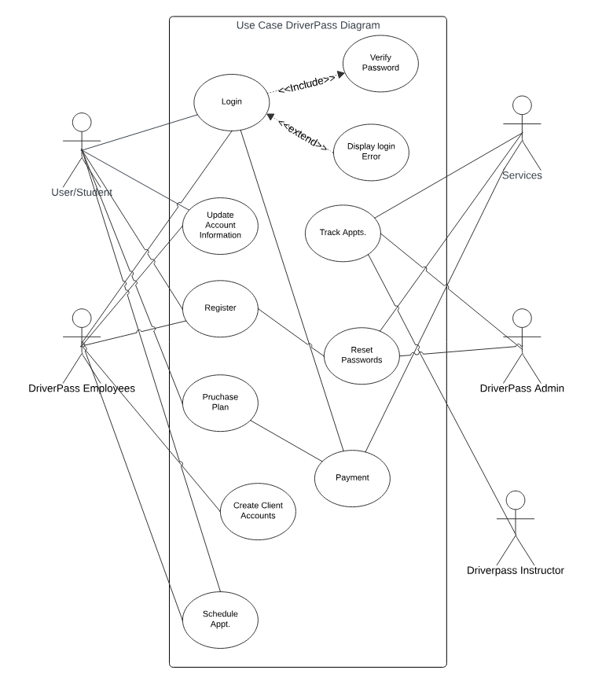
Use Case Diagram
[Insert your use case diagram here.]
Notes:
[Explain your diagram. Who are the different actors in the system? What are the different use cases? How did you account for DriverPass’s needs in your design? In your explanation, keep your audience in mind. Avoid the use of terms like “actors” and “use cases” in your explanation.]

Slide 4
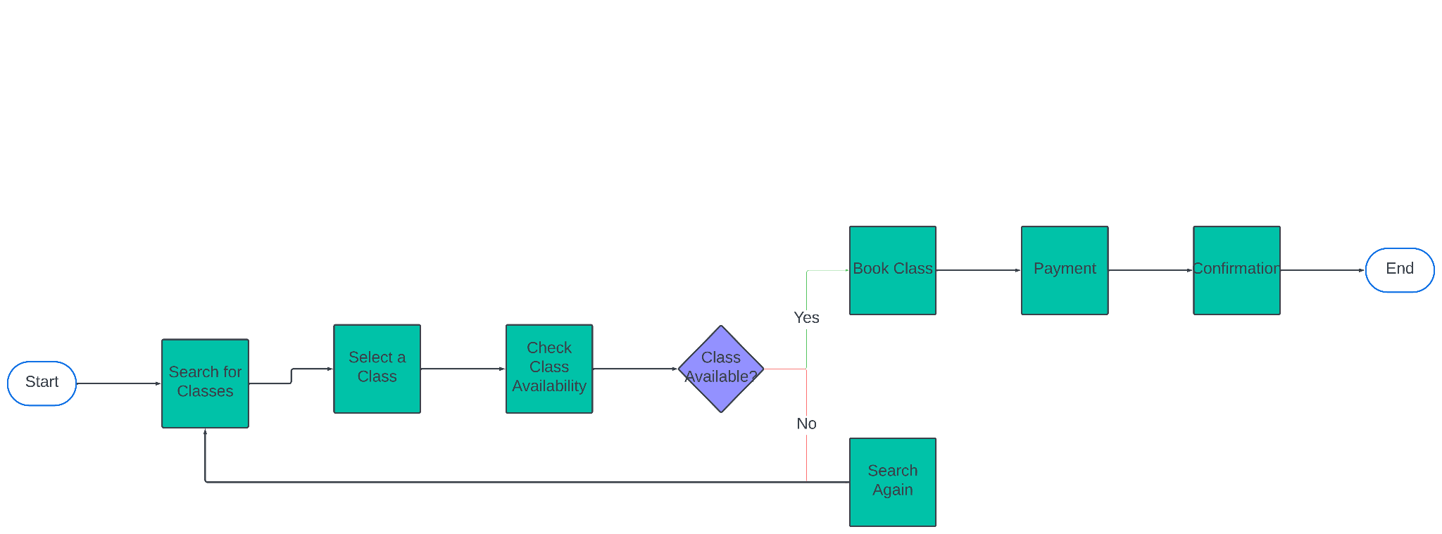
Activity Diagram
Notes:
[Explain your diagram. Which use case are you breaking down? What are the steps for this use case? How did you account for DriverPass’s needs in your design? In your explanation, keep your audience in mind. Avoid the use of technical terms such as “nodes,” “control flows,” and so on.]

Slide 5
Security
To enhance security, accessing a user account in the DriverPass system should require a password.
To prevent fake accounts or unauthorized access, authentication via email could be implemented.
It's recommended that developers utilize HTTPS as the protocol for sending and receiving data to ensure secure communication.
Users should have the option to reset their passwords via email if forgotten, while the system should also impose limits on login attempts to deter brute force attacks.
In case of forgotten passwords or usernames, users should be able to retrieve their accounts through a password reset process initiated via their email address.
Notes:
[How did you consider security in your design? In your explanation, keep your audience in mind by avoiding the use of technical terms.]

Slide 6
System Limitations
Driverpass may be limited to specific regions or countries due to regulatory, legal, or operational constraints.
Drivers must meet certain qualifications or criteria (such as age, experience, or licensing requirements) to use Driverpass.
Driverpass may have limitations on payment methods accepted
The Driverpass system may have technical limitations, such as compatibility with specific devices or operating systems, which could impact user accessibility.
Notes:
[What are the limitations of your design? In your explanation, keep your audience in mind by avoiding the use of technical terms.]

